Slide 1

SENA NUR ULUKAYA
GÖKBEY GAZİ KESKİN
EMRE SEZER
YUNUS SEFA BAYRAK
BİLAL YALÇINKAYA
CSE 101 TERM PROJECT:
CONSOLE SNAKE GAME V1.5

Slide 2
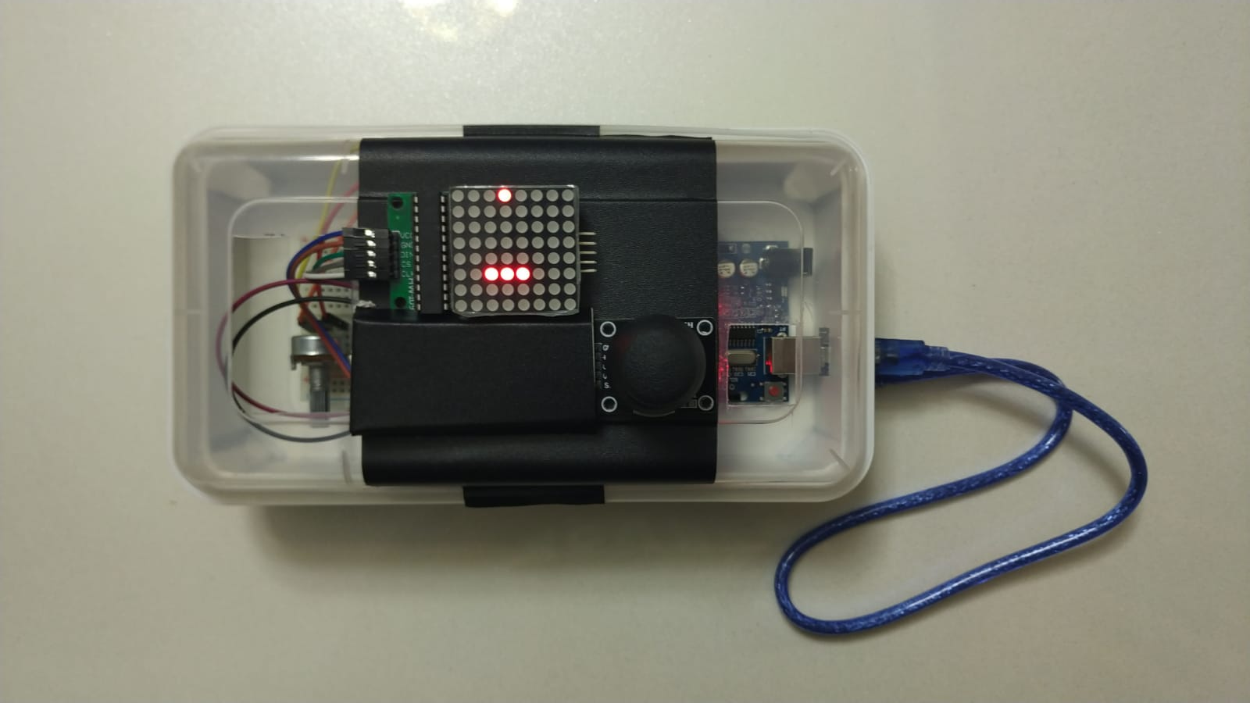
WE REMADE THE LEGENDARY SNAKE GAME OF NOKIA 3310!

Slide 3
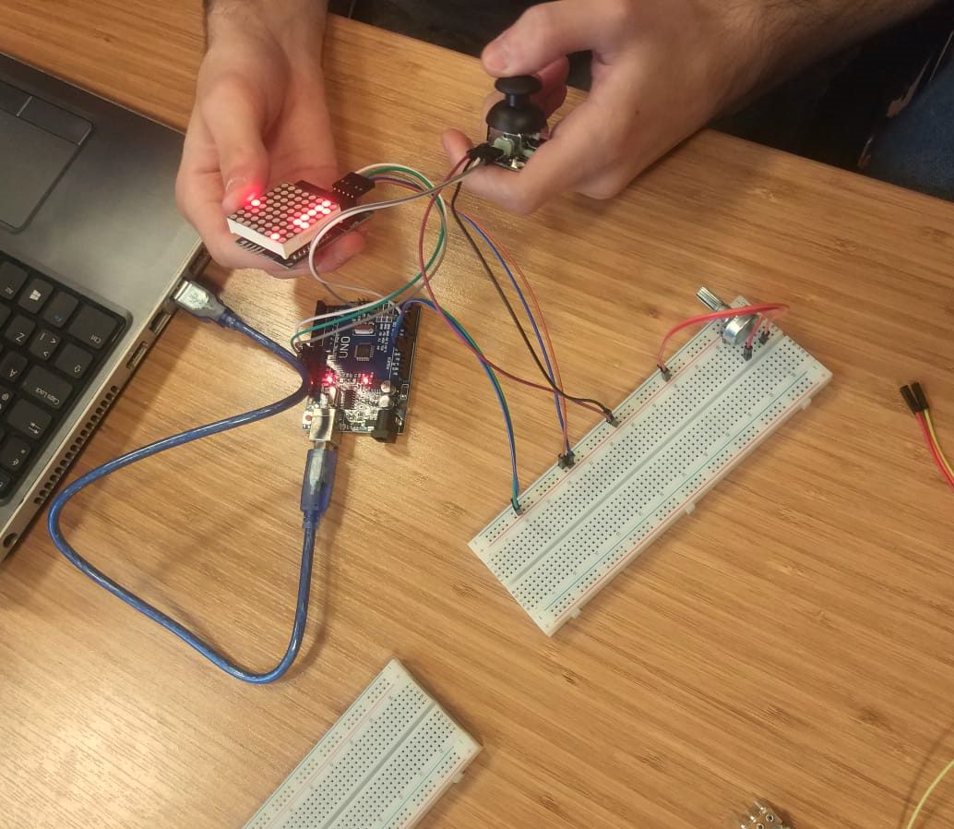
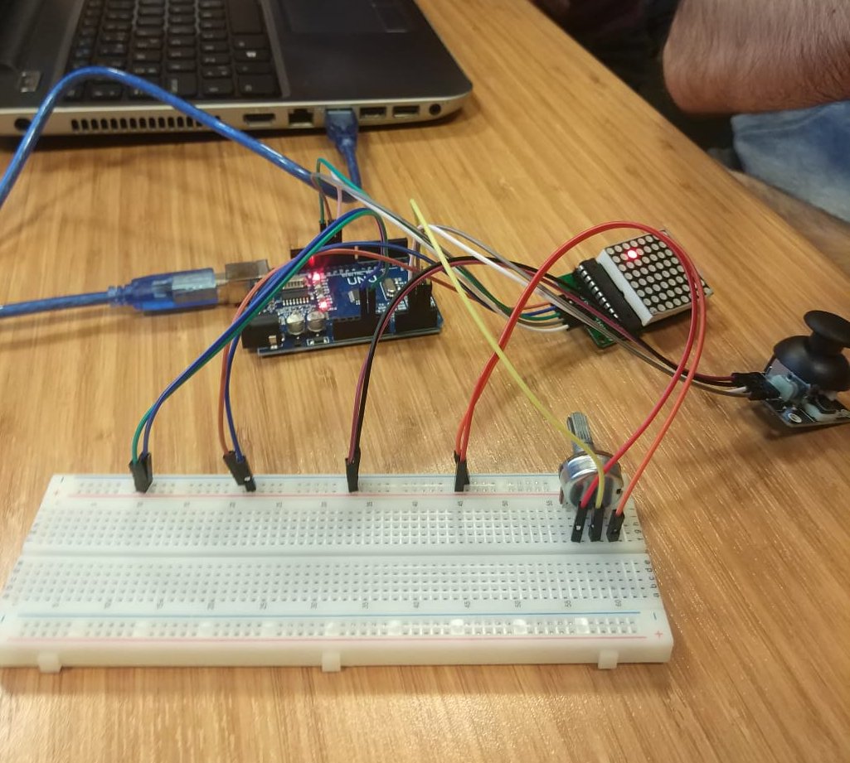
HERE ARE SOME STEPS:

Slide 4
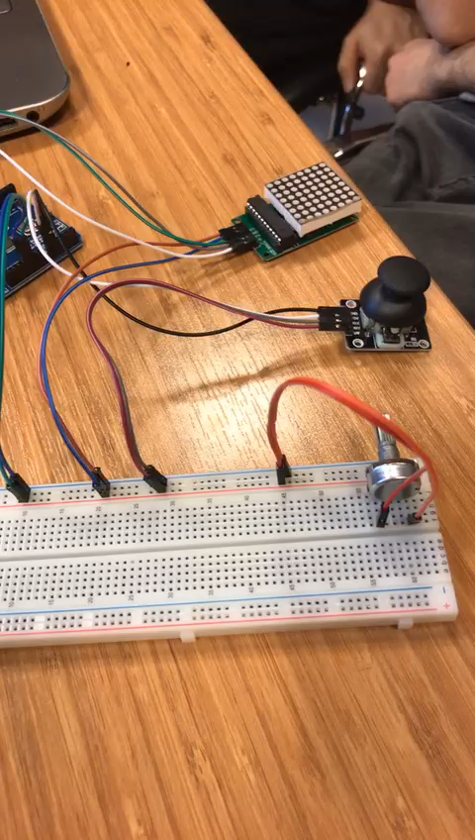
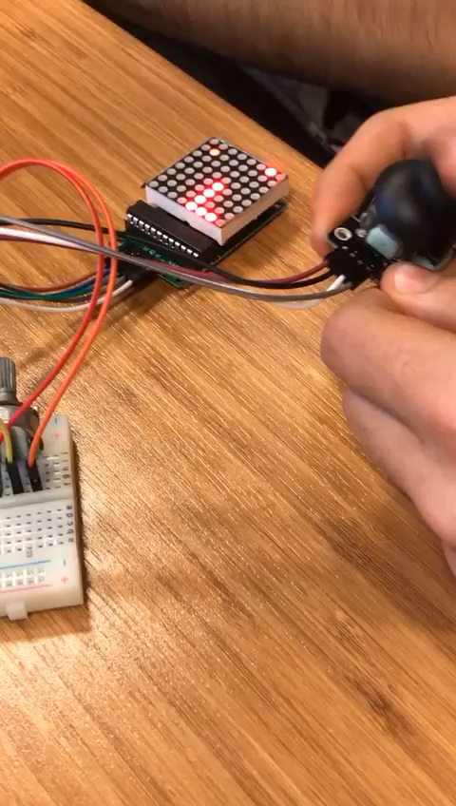
FIRST TRIES →

Slide 5
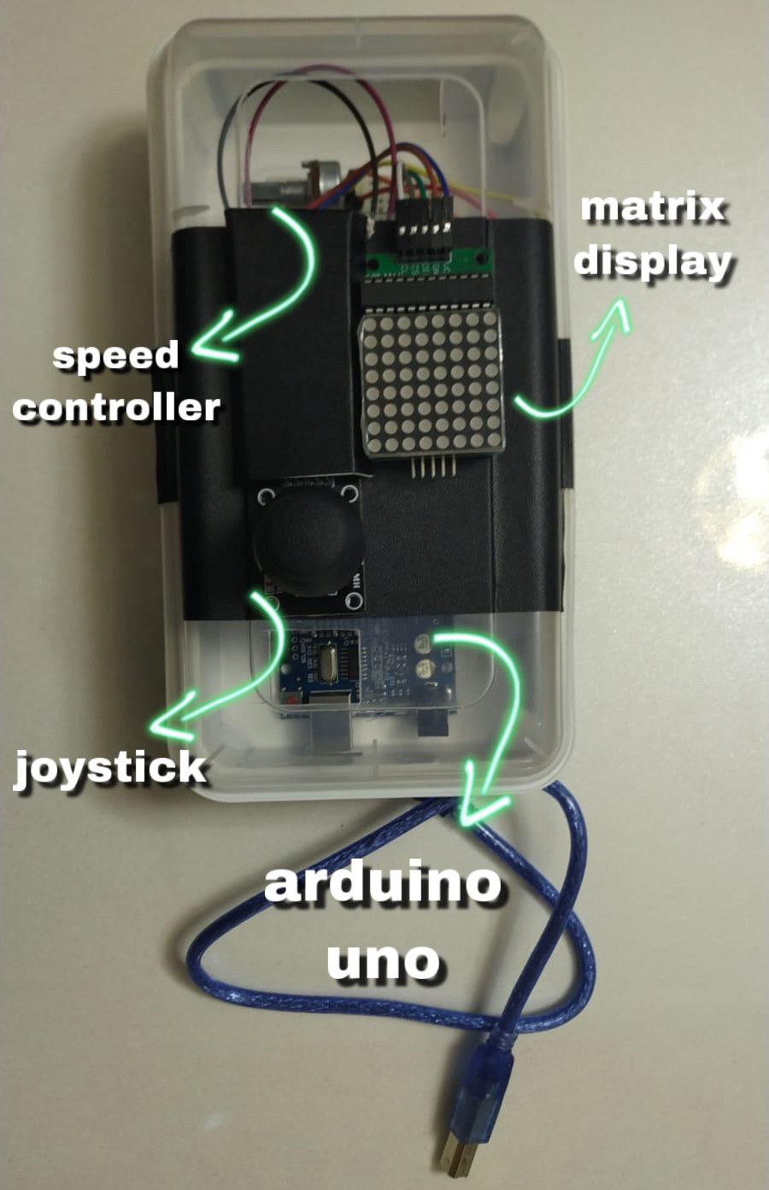
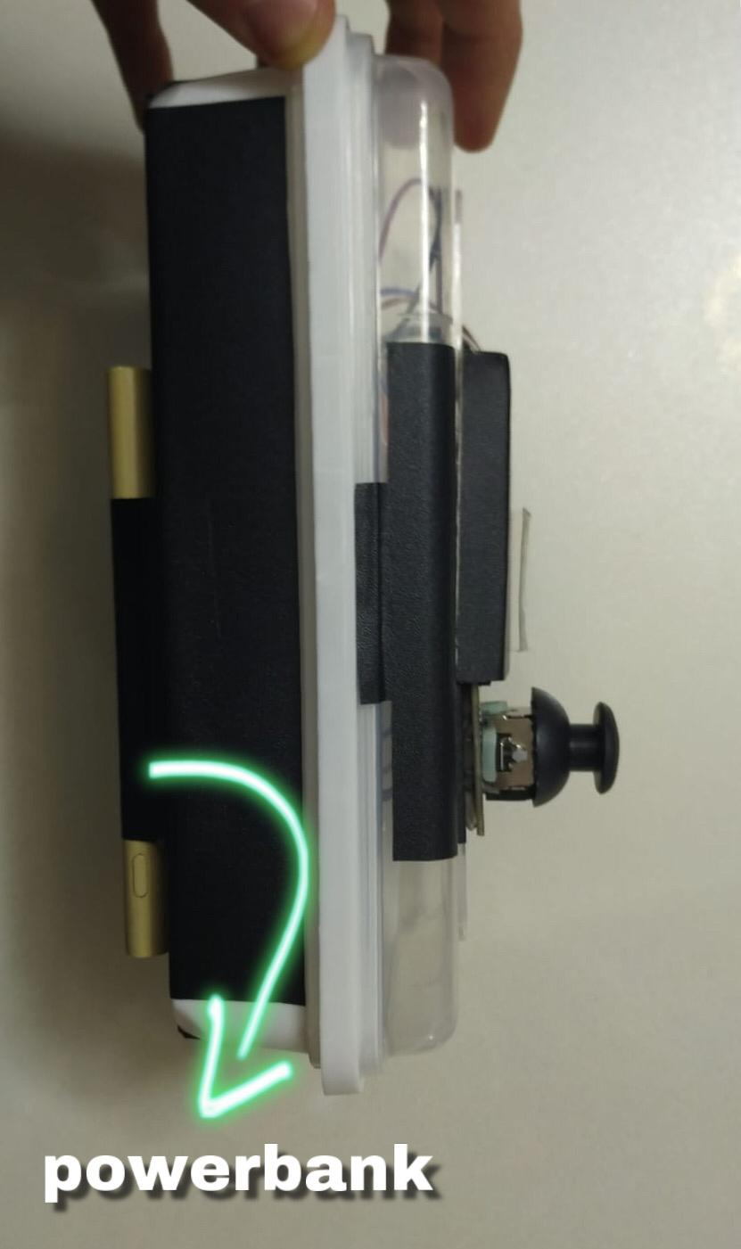
HERE’S THE LAST VERSION OF THE SNAKE GAME →

Slide 6
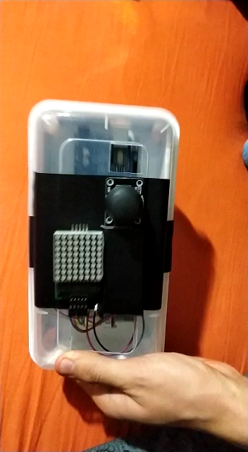
YOU WILL FEEL NOSTALGIC AND HAVE FUN WHILE PLAYING WITH IT!

Slide 7
THANK YOU FOR LISTENING!

